Slide 1
Java BASIC

Slide 2
Java Syntax
public class MyClass {
public static void main(String[] args) {
System.out.println("Hello World");
}
}
Every Syntax or code must be inside the Class, Here we create the class as name “MyClass” as the Naming convention the class name must start with Upper letter.
Note: Java is case sensitive program i.e MyClass and myclass are different. The name of the java file must match the class name. When saving the file, save it using the class name and add ".java" to the end of the filename.

Slide 3
Main() method
method is the entry point of the program from where the program start to run or execute.
System.out.println("Hello World");
we can use the println() method to print a line of text to the screen

Slide 4
Java Comments
Comments are used to describe the java code, and make to more readable for other programmer but most of the time developer also use the comment to run the alternate code or test the code.
Single Line comment
In java programming // “double back slash” are used for the single line comment
Example:
//this is comment
Multi line comment:
For multi line comment we use /* comment */
Here previous /* denotes the start of the comment and post */ denotes the end of the comment.
Example:
/*
this is multi line
Comment
*/

Slide 5
Java Variables
Variables are containers for storing data values.
String - stores text, such as "Hello". String values are put inside the double quotes
int - stores integers (whole numbers), without decimals, such as 145 or -145
float – stores the number with decimals, such as 19.99 or -19.99
char - stores single characters, such as 'a' or 'B'. Char values are surrounded by single quotes.
boolean - stores values with two states: true or false

Slide 6
Declaration
Syntax:
type variable = value;
Example:
int myNum = 5;
float myFloatNum = 5.99f;
char myLetter = 'D';
boolean myBool = true;
String myText = "Hello";

Slide 7
Final keyword
final int a = 10;
you can add the final keyword if you don't want others (or yourself) to overwrite existing values (this will declare the variable as "final" or "constant", which means unchangeable and read-only):

Slide 8
Declare Many Variables
To declare more than one variable of the same type, use a comma-separated list:
int x = 5, y = 6, z = 50;
System.out.println(x + y + z);

Slide 9
Java Identifiers
Java variables must be identified with unique names.These unique names are called identifiers.
Java identifiers can be short name like x and y or more descriptive name like age, address etc.
it is recommended to use descriptive names in order to create understandable and maintainable code:
String address = “Kathmandu”

Slide 10
Naming convention for Unique Identifer
The general rules for constructing names for variables (unique identifiers) are:
Names can contain letters, digits, underscores, and dollar signs
Names must begin with a letter
Names should start with a lowercase letter and it can not contain whitespace
Names can also begin with $ and _ but not recommended.
Names are case sensitive ("myVar" and "myvar" are different variables)
Reserved words (like Java keywords, such as int or boolean) cannot be used as names

Slide 11
Java Type Casting
Type casting is process of converting one primitive type to another primitive type.
There is two type of casting:
Automatic casting
int a = 10;
double x = 10.0;
b. Manual casting: casting must be done manually by placing the type in parentheses in front of the value
double x = 10.12;
Int a = (int) x;

Slide 12
Data Type
Data type specifies the type of data and size of the data can be sorted in the variable.
In java there is two Data type in java.
Primitive Data type :
primitive data types include Boolean, char, byte, short, int, long, float and double.
2. Non-primitive data types :
The non-primitive data types include String,Classes, Interfaces, and Arrays.

Slide 13
Operators in Java
Operators help to perform different operation on oparands in programming.
The symbol which is used to perform the operations for example, +,-,*,% etc
There are many operator in java which is given below:
1.Unary operator :
postfix: a++
prefix: ++a
2. Arithmetic : +,-,*, /, %
3.Logical operator : &&, ||
4.Ternary : ? :
5.Assignment operator : =, +=,-=,*=,%=
6.Relational operator : >,<, >=,<=, ==, !=
7.Bitwise operator : AND → &, OR → ^ , XOR → |

Slide 14
Access Modifier :
Access modifiers (or access specifiers) are keywords in object-oriented languages that set the accessibility of classes, methods, and other members. Access modifiers are a specific part of programming language syntax used to facilitate the encapsulation of components.
Encapsulation : This concept is also often used to hide the internal representation, or state, of an object from the outside.
In Java, access modifiers are used to set the accessibility (visibility) of classes, interfaces, variables, methods, constructors, data members, and the setter methods.
class Animal {
public void method1() {...}
private void method2() {...}
protected void method2() {...}
}

Slide 15
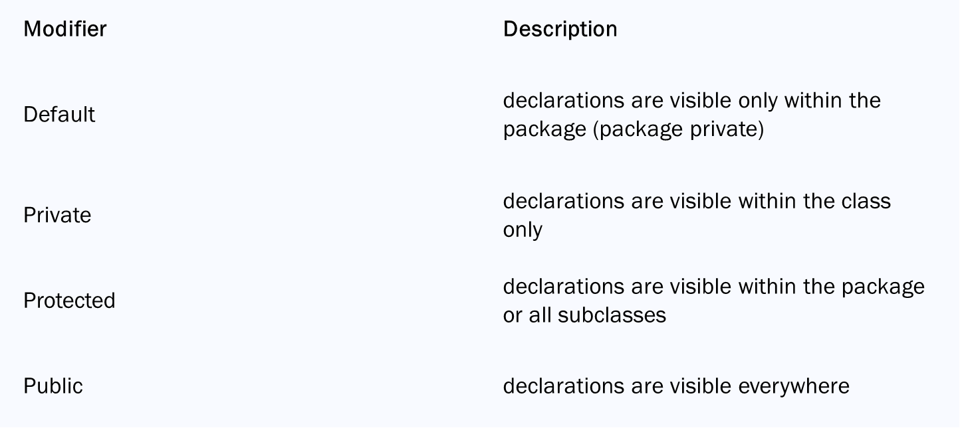
Type of Access Modifier :

